Slide 1
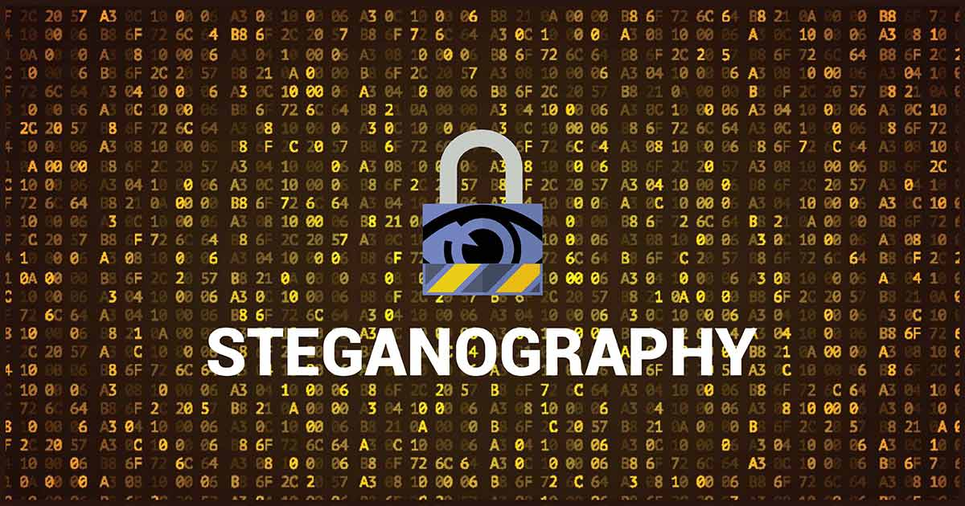

secure data hiding in images using steganography
CAPSTONE PROJECT
Presented By: KASIREDDY DIVYA TEJ
Student Name : KASIREDDY DIVYA TEJ
College Name & Department : CHAITANYA ENGINEERING COLLEGE(MECHANICAL)

Slide 2
OUTLINE
Problem Statement
Technology used
Wow factor
End users
Result
Conclusion
Git-hub Link
Future scope

Slide 3
Problem Statement
Traditional steganography techniques have limited amount of capacity, restricting the amount of data that can be securely hidden in an image without noticeable distortion.
Detection of modifications, due to increase in embedding strength which resulting degradation in “image quality”.
Advance stenography algorithms requiring high computational power, making impractical to imply in real time applications.
Steganography provides the way to hide confidential and important data within an image,making it undetectable.
In this project, we secure data hiding using LSB steganography.

Slide 4
Technology used
LIBRARIES :
OpenCV (cv2) for image reading.
OS (os) for the opening of encrypted image file.
String (string)
Platforms :
Python idle.
Python program.

Slide 5
Wow factors
Hides data by modifying the pixel values without use of any external libraries.
Use of ASCII conversion for encoding and decoding.
Require password for decryption, adding security.
Use of basic python functions and OpenCV, to construct the code.
Encryption and Decryption messages with correct password.
Unique Features :

Slide 6
End users
Cybersecurity Professionals : To develop and test secure data-hiding techniques (e.g., encryption keys, passwords.)
Forensic Investigators – For covert communication and forensic watermarking.
Journalists & Whistleblowers – To securely transmit sensitive information without detection (e.g., reports, news.)
Cryptography & Steganography Researchers – To experiment with data hiding and retrieval techniques.

Slide 7
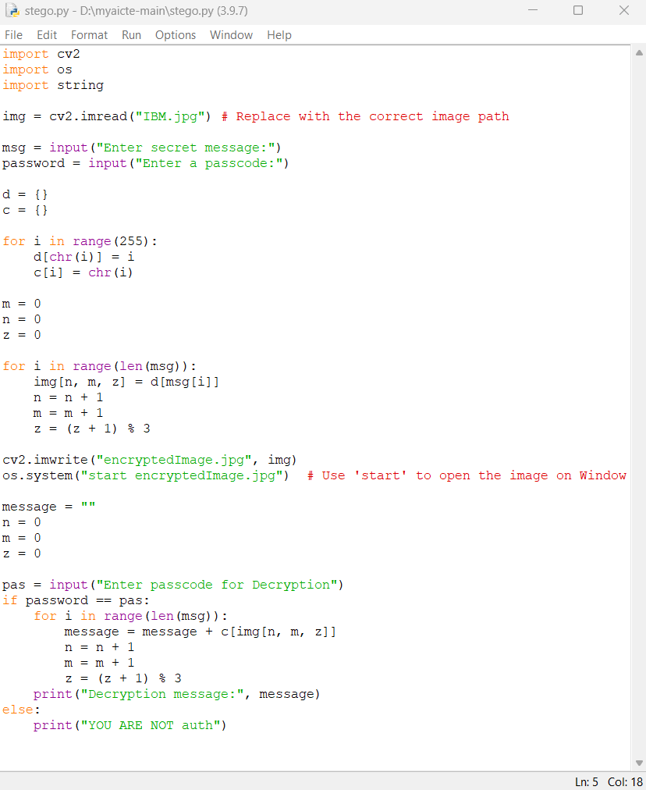
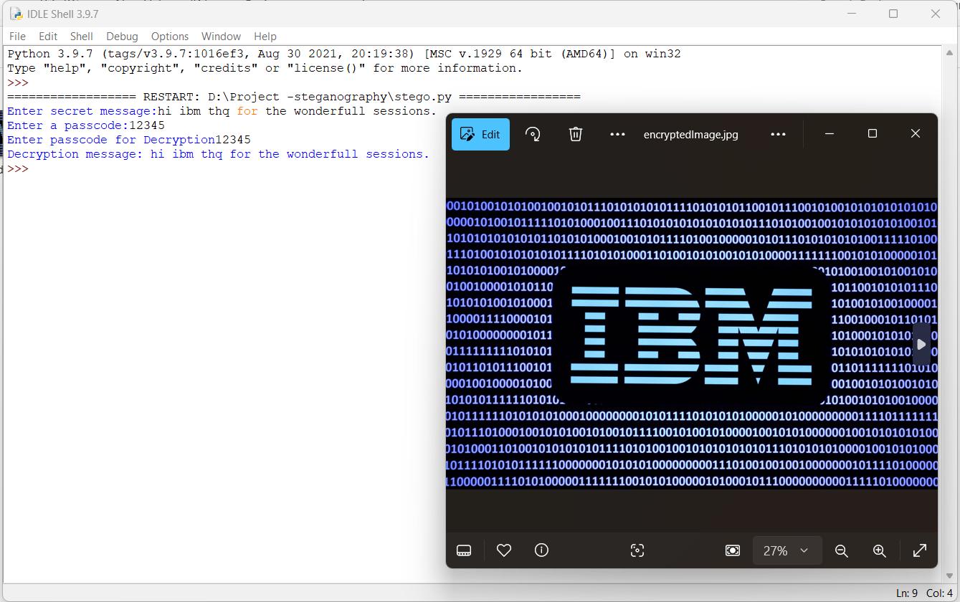
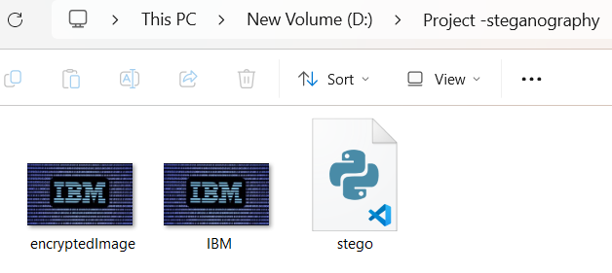
Results
THE CODE
ENCRYPTION & DECRYPTION

Slide 8
Conclusion
The project successfully implements secure data hiding in images using LSB steganography.
The solution is robust, user-friendly, because data can be stored in images and transmitted between operatives without use of obvious encryption methods. suiting real world applications.
Future enhancements can include support for additional file formats and improved error handling.

Slide 9
GitHub Link
Repository : https://github.com/dtej718/AICTE-PROJECT-STEGANOGRAPHY.git

Slide 10
Future scope(optional)
Supports multiple image formats and higher resolution images.
Combination of AES,RSA or Quantum encryption with steganography for enhance security.
AI based dynamic encryption algorithm based on risk of detection.
Deep learning models create more complex undetectable patterns of data.
New techniques that keeps data hidden even after JPEG compression or resizing.

Slide 11
THANK YOU

